Slide 1
Wrestling with Weed
in the Workplace

Slide 2
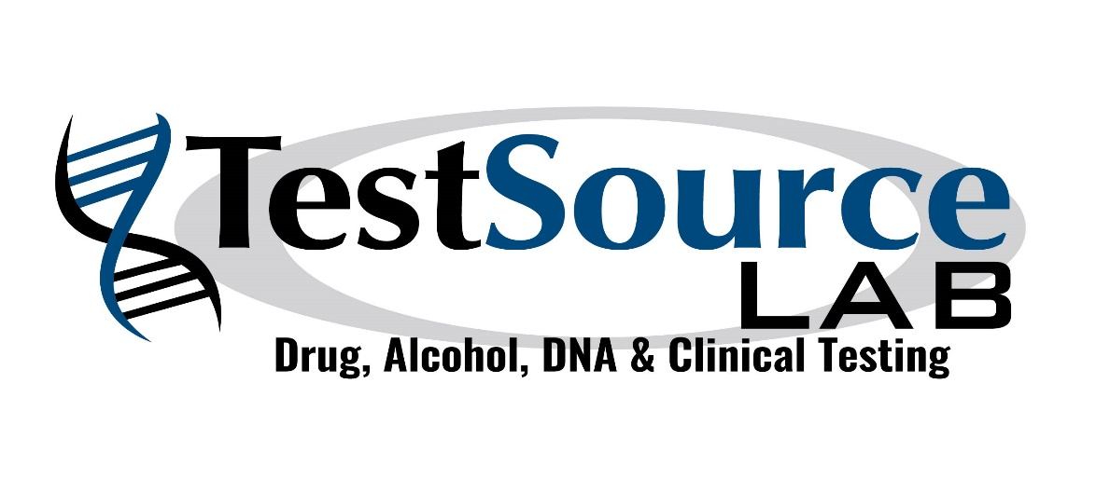
Wrestling with Weed in the Workplace
Presented by:
Rick Van Laan | 269.459.4044 | rvanlaan@testsourcelab.com

Slide 3
Detection Times for Marijuana Use: Hair, Urine & Saliva.
Hair: Starting at 9 days, goes back 90 days
Urine: 4 hours to up to 30 days
Saliva: Immediate up to 48 hours.

Slide 4
What drug test specimen should be ordered to detect Marijuana use?
It depends on the reason you are conducting the testing.
Hair testing is not useful for post accident or reasonable suspicion testing.
Candidates become aware if you conduct saliva testing on set days such as the first day of orientation and they often avoid use for a day or two, so marijuana clears the body.

Slide 5
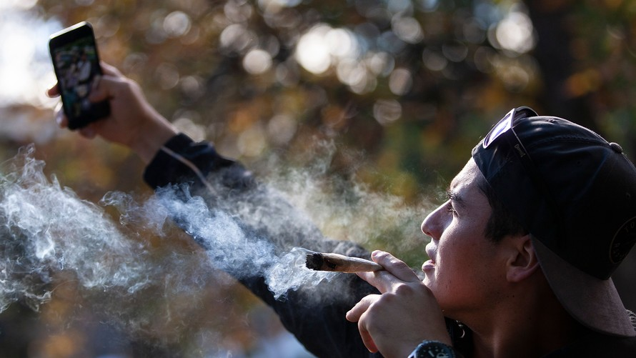
Is there a drug test that currently exists to tell “How High” or impaired an employee is at the time?
No
Current tests tell whether the marijuana metabolite is in your system, but not how impaired you are.

Slide 6
Is there a drug test that currently exists to tell “How High” or impaired an employee is at the time?
Science has not caught up to a quantitative measure of how intoxicated a person currently is – like a BAC measurement for alcohol.
Hound Labs has developed a device that can detect whether a person has smoked pot in the last two hours using a breathalyzer. It gives a positive or negative but not a quantifiable figure.

Slide 7
Will CBD’s test positive for Marijuana?
Maybe.
CBD itself would not report positive for marijuana or marijuana metabolite. If the CBD product contains THC at a sufficiently high concentration, it is possible, depending on usage patterns, that the use of these products could cause a positive urine drug test result for marijuana metabolites. For example, in some states, CBD may contain up to 5% THC.
Hemp – a variety of the cannabis plant regulated by the U.S. Department of Agriculture – is legal, so long as its THC content is negligibly low. But because the agriculture department doesn’t test for CBD - only THC - more companies are getting away with selling products they say contain CBD. Consumer Reports: https://www.consumerreports.org/cbd/can-you-take-cbd-and-pass-a-drug-test/
When sampling the hemp plant, “the closer you get to the flower, the higher the THC content. So some states collect the top 6 inches of the plant, while others do it differently,” DeLucia says. Quest Diagnostics: https://blog.employersolutions.com/cannabidiol-and-drug-tests/
While some CBD oils claim to be isolates, they may be full spectrum oils and actually contain more cannabinoids (such as THC) than they claim. https://www.verywellhealth.com/cbd-oil-and-failing-drug-tests-4580277

Slide 8
